Slide 1
SEN-220 SOFTWARE ENGINEERING
THE NATURE OF SOFTWARE

Slide 2
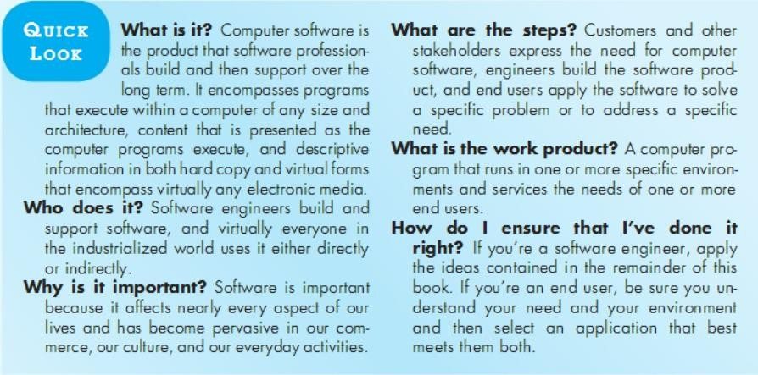

Slide 3
INTRODUCTION TO SOFTWARE ENGINEERING
Software is a program or set of programs containing instructions that provide desired functionality.
Engineering is the process of designing and building something that serves a particular purpose and finds a cost- effective solution to problems.

Slide 4
INTRODUCTION TO SOFTWARE ENGINEERING
Software Engineering is a systematic, disciplined, quantifiable study and approach to the design, development, operation, and maintenance of a software system.

Slide 5
OBJECTIVES OF SOFTWARE ENGINEERING-MAINTAINABILITY
It should be feasible for the software to evolve to meet changing requirements.

Slide 6
OBJECTIVES OF SOFTWARE ENGINEERING-EFFICIENCY
The amount of software developed, or requirement divided by the number of resources used like time, effort,
among other examples.
The software should not make wasteful use of computing devices such as memory, processor cycles, etc.

Slide 7
OBJECTIVES OF SOFTWARE ENGINEERING-CORRECTNESS
A software product is correct if the different requirements as specified in the SRS document have been correctly implemented.

Slide 8
OBJECTIVES OF SOFTWARE ENGINEERING-REUSABILITY
A software product has good reusability if the different modules of the product can easily be reused to develop new products.

Slide 9
OBJECTIVES OF SOFTWARE ENGINEERING-TESTABILITY
Here software facilitates both the establishment of test criteria and the evaluation of the software with respect to those criteria.

Slide 10
OBJECTIVES OF SOFTWARE ENGINEERING-RELIABILITY
It is an attribute of software quality. The extent to which a program can be expected to perform its desired function, over an arbitrary time period.

Slide 11
OBJECTIVES OF SOFTWARE ENGINEERING-PORTABILITY
Portability in the context of software refers to the ability of a program or application to run on different platforms or operating systems without modification. Example Mozilla Firefox Web Browser

Slide 12
OBJECTIVES OF SOFTWARE ENGINEERING-ADAPTABILITY
Software adaptability refers to the capability of a software system to adjust and respond effectively to changing conditions, requirements, or environments without the need for extensive modification or reengineering. It is the software's ability to accommodate different situations, configurations, or user preferences seamlessly.
Example: Grammarly Software with Microsoft word.
Language Adaptation: In language learning software, it can adapt to the user's native language and proficiency level, tailoring exercises and lessons accordingly.

Slide 13
OBJECTIVES OF SOFTWARE ENGINEERING-INTEROPERABILITY
The ability of computer systems or software to exchange and make use of information.
◾
"interoperability between devices made by different manufacturers"
Example: The Email System, Smart Home Ecosystem

Slide 14
PROGRAM VS SOFTWARE PRODUCT
Program:
Program: A program is a set of instructions or code written to perform a specific task or function on a computer. It is a collection of commands that tells the computer what to do, often used to execute a single task or process. Programs can be simple scripts or complex applications.
Software Product:
Software Product: A software product is a complete and packaged computer program or application that is designed, developed, and distributed for use by end-users or organizations. It serves specific functions or tasks, undergoes a development lifecycle, and often comes with documentation, user interfaces, and licensing agreements. Software products are intended for widespread use and may include operating systems, games, program suites and more.

Slide 15
SOFTWARE APPLICATION DOMAINS-SYSTEM SOFTWARE
System software is software designed to provide a platform for other software.
Examples of system software include operating systems (OS) like macOS, Linux, Android and Microsoft Windows, computational science software, game engines, search engines, industrial automation, and software as a service applications.

Slide 16
SOFTWARE APPLICATION DOMAINS-APPLICATION SOFTWARE
Application software is software that allows users to do user-oriented tasks such as create text documents, play or develop games, create presentations, accounting softwares, listen to music, draw pictures or browse the web.

Slide 17
SOFTWARE APPLICATION DOMAINS-ENGINEERING/SCIENTIFIC SOFTWARE
Such software is written for specific applications using principles, techniques, and formulae specific to that field.
Examples are software like MATLAB, AUTOCAD, PSPICE, ORCAD, etc

Slide 18
SOFTWARE APPLICATION DOMAINS- EMBEDDED SOFTWARE APPLICATIONS
Embedded software applications are specialized programming within non-PC devices – either as part of a microchip or as part of another application that sits on top of the chip – to control specific functions of the device

Slide 19
SOFTWARE APPLICATION DOMAINS-WEB/MOBILE APPLICATIONS
This network-centric software category spans a wide array of applications and encompasses both browser-based apps and software that resides on mobile devices.

Slide 20
SOFTWARE APPLICATION DOMAINS-ARTIFICIAL INTELLIGENCE SOFTWARE
Artificial Intelligence (AI) Software is a computer program which mimics human behavior by learning various data patterns and insights.
Top features of AI software include Machine Learning, Speech & Voice Recognition,Virtual Assistant etc.
AI combined with Machine learning is used to provide users with the required functionality and make the business process a much simpler one.
AI software is used to build and develop an intelligent application from scratch with the help of Machine learning and deep learning capabilities.

Slide 21

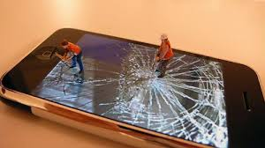
Software does not wear out but Legacy
The older program often referred to as Legacy Software….

Slide 22
Legacy Software
Have poor quality
Inextensible design
Complicated code
Poor/no documentation
They still perform core business functions & indispensable
We do nothing until they go for significant change

Slide 23
Legacy Software
Significant change/ maintenance
Adaptation
Enhancement
Correction

Slide 24
LEGACY SOFTWARE
A legacy system is outdated computing software and/or hardware that is still in use.The system still meets the needs it was originally designed for, but doesn’t allow for growth.What a legacy system does now for the
company is all it will ever do. A legacy system’s older technology won’t allow it to interact with newer systems.
As technology advances, most companies find themselves dealing with the issues caused by an existing legacy system. Instead of offering companies the latest capabilities and services — such as cloud computing and better data integration — a legacy system keeps a company in a business rut.

Slide 25
LEGACY SOFTWARE-EXAMPLES
Microsoft Windows 7:Windows 7 officially became a legacy operating system in January 2020 after Microsoft halted security updates and support for it. However, over 100 million machines continue to run this operating system.
COBOL: Common Business-Oriented Language or COBOL is still used 55 years after its development. Forty- eight percent of businesses and government organizations reportedly depend on this language more than others.
Discontinued Oracle products: Oracle database software such as E-Business Suite and Peoplesoft

Slide 26
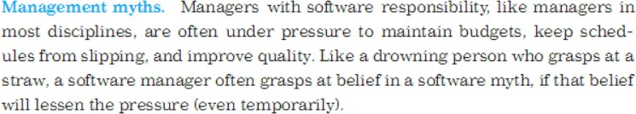
SOFTWARE DEVELOPMENT MYTHS

Slide 27
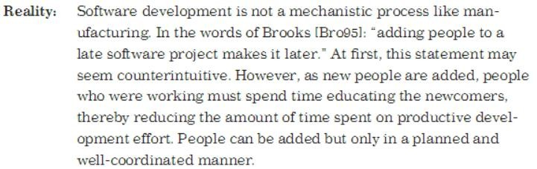
SOFTWARE DEVELOPMENT MYTHS

